Slide 1

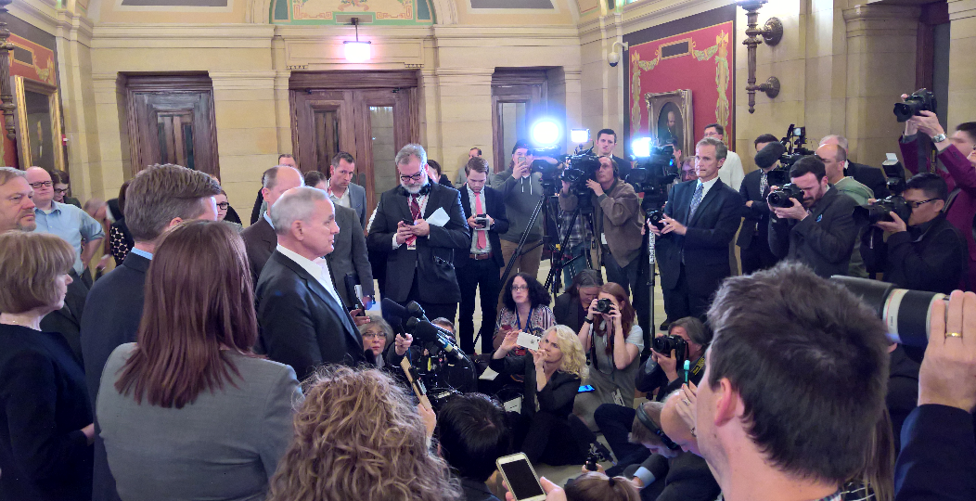
Do you remember…
Celebrating 50 years

Slide 2
2017
The many calls, e-mails and personal contacts by MGEC members helped and clearly kept their issue in the awareness of negotiators.
Celebrating 50 years

Slide 3
TRIVIA:
How many members have served TWICE as MGEC president? Can you name any of them?
Celebrating 50 years

Slide 4
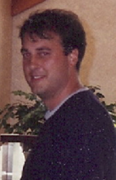
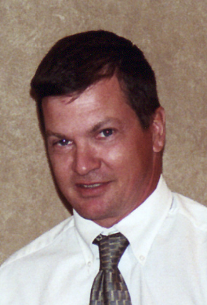
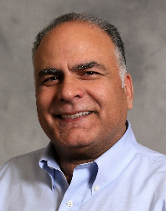
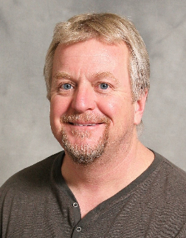
ANSWER:
Only FOUR members have served more than one term as president in MGEC’s 50 year history:
Terry Beaudry, Jim Sellner,
Mohammad Dehdashti, and Steve Kordosky
  Terry Beaudry (MnDOT): 1995-1996, 2002-2003
  Jim Sellner (DNR) 2000-2001, 2006-2007
  Mohamed Dedashti (MnDOT): 2012, 2015
  Steve Kordosky (MnDOT): 2016, 2018
Celebrating 50 years

Slide 5
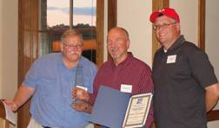
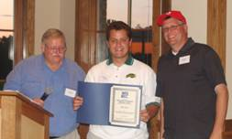
Do you remember…
Celebrating 50 years

Slide 6
2008
Awards Committee Chair Len Leitner (MnDOT) (left) and President Joe Pignato (right) present the 2008 Golden Slide Rule Award to Dave Dahlberg (MnDOT) (center)
Celebrating 50 years
Ben Jilk (MnDOT) (above-center), is awarded the
2008 Connie Minetor Memorial Scholarship

Slide 7
TRIVIA:
Do you know what the Distinguished Citizenship Award is? Do you know any past recipients?
Celebrating 50 years

Slide 8
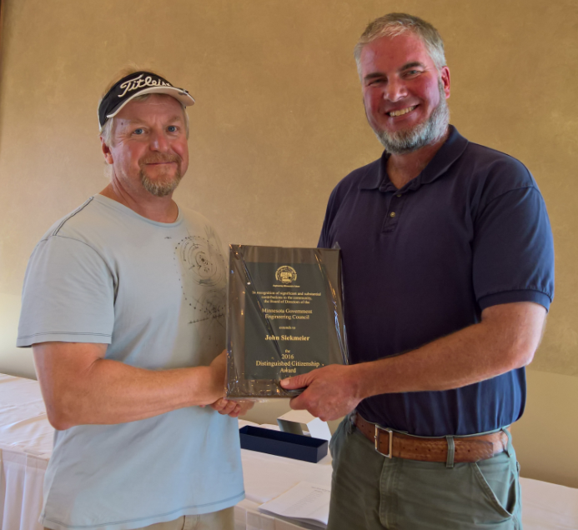
ANSWER:
The Distinguished Citizenship Award recognizes significant and substantial contributions to community service. Some recipients have included:
Celebrating 50 years
John Siekmeier, MnDOT (2016)
Marcelo Alojado, MnDOT (2011)
Jim Sellner, DNR (2007)
Fred Jenness, MPCA (2006)
Steven Porter, MnDOT (2004)
George Cepress, MnDOT (2003)
Daniel Sullivan, MPCA (2002)
Raymond Burrows, Health Dept. (2002)
David Beberg, MnDOT (2001)
Lynnette Roshell, MnDOT (1999)
Fred Maurer, MnDOT (1997)
Alex Poletz, MnDOT (1996)

Slide 9
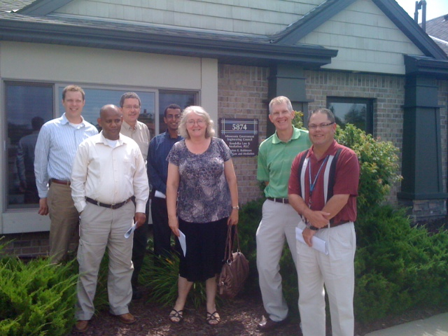
Do you remember…
Celebrating 50 years

Slide 10
2011
Celebrating 50 years
PE Review Instructors:
(left to right)
Joe Nietfeld,
Girma Feyissa,
Bill Priebe,
Solomon Woldeamlak, Petra DeWall,
Randy Thorson,
Dave Sahli

Slide 11
TRIVIA:
How many women have served as MGEC president? How many are here tonight?
Celebrating 50 years

Slide 12
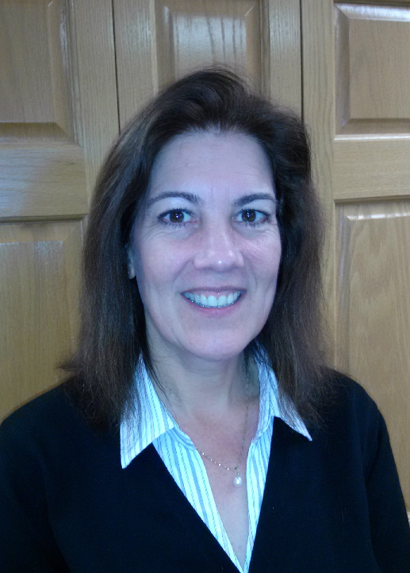
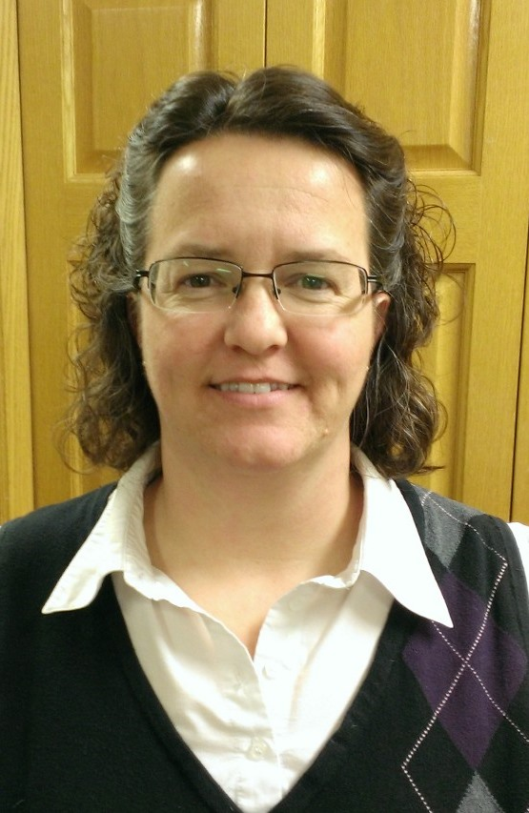
ANSWER:
Two women have served as MGEC president:
Linda Heath (2011) and Julie Groetsch (2017)
Celebrating 50 years

Slide 13
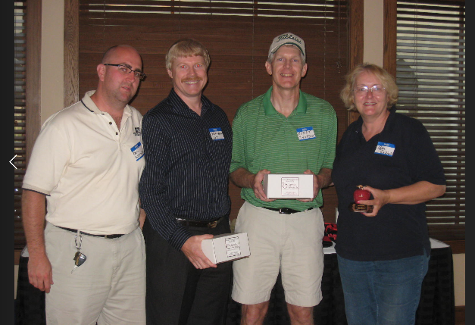
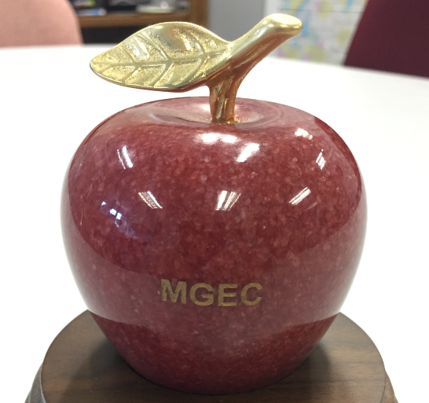
Do you remember…
Celebrating 50 years

Slide 14
2009
Celebrating 50 years
PE Exam Review Instructor Awards
Length of service awards were presented by Paul Kettleson (left) to: Blake Nelson, MnDOT (17 years); Bill Priebe, MPCA (15 years) [not pictured]; Randy Thorson, MPCA (12 years); Rich Lamb, MnDOT (12 years) [not pictured]; and Petra DeWall, MnDOT (10 years).

Slide 15
TRIVIA:
How many MGEC presidents have been from non-MnDOT agencies?
Celebrating 50 years

Slide 16
ANSWER:
Our first MGEC president was from Hennepin County. Two have been from the MPCA, and one each from the DNR and Health. Forty two have worked at MnDOT
Celebrating 50 years
MGEC encourages our members at every department to become engaged and run for office. Two Director positions are designated for other agencies whenever candidates are available.

Slide 17
Do you remember…
Celebrating 50 years
The Board announced the initiation of a new member-only scholarship, the Connie Minetor Memorial Scholarship, named for the late Connie Minetor, MGEC’s first President from MPCA (1997-98).

Slide 18
2002
Celebrating 50 years
In 2002, the Board announced the initiation of a new member-only scholarship, the Connie Minetor Memorial Scholarship, named for the late Connie Minetor, MGEC’s first President from MPCA (1997-98).

Slide 19
TRIVIA:
Do you know what the Golden Slide Rule Award is? Do you know any past recipients?
Celebrating 50 years

Slide 20
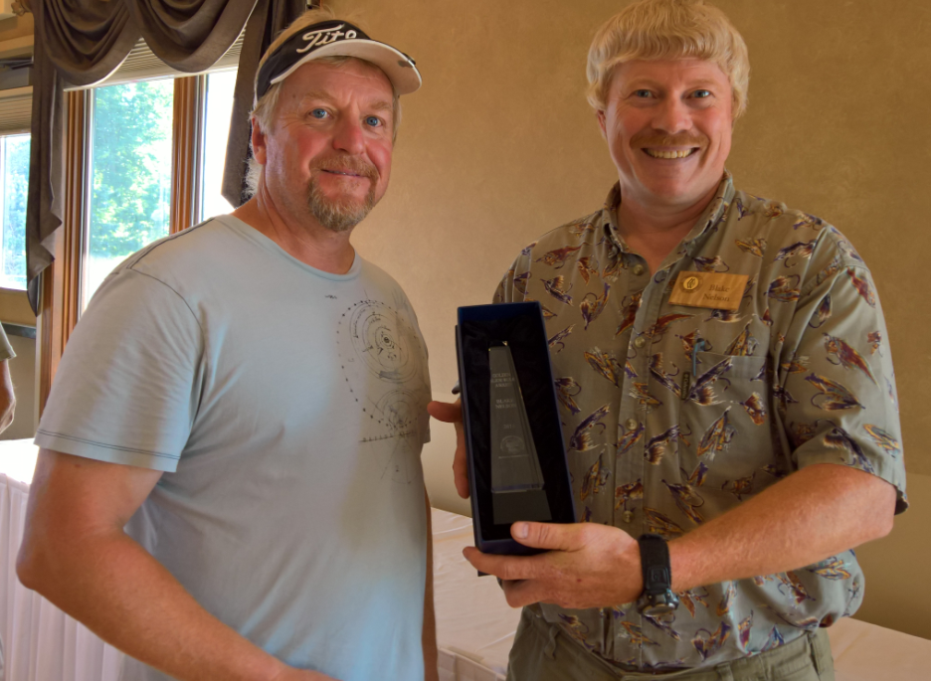
ANSWER:
The Golden Slide Rule Award recognizes significant and substantial achievements in the fields of engineering or land surveying. Some recipients have included:
Celebrating 50 years
Blake Nelson, MnDOT (2016)
Paul Kettleson MnDOT, (2011)
Mike Pretel, MnDOT (2009)
Dave Dahlberg, MnDOT (2008)
Chris Kufner, MnDOT (2007)
Raymond Cekalla, MnDOT (2006)
Chun Yi Wu, MPCA (2005)
Brad Estochen, MnDOT
& Rajan Thomas, Administration (2004)
Daryl Taavola, MnDOT (2002)
Hongming Jiang, MPCA (2001)
Lih-in Rezania, Health Dept. (1999)
Memos Katsoulis, DNR (1998)
J.T. Staley, MnDOT (1997)
Marthand Nookala, MnDOT (1996)

Slide 21
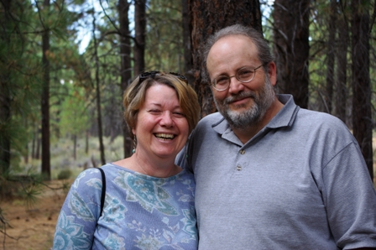
Do you remember…
Celebrating 50 years

Slide 22
1996-2002
Celebrating 50 years
Glenn West served as MGEC Executive Director 1996-2002
(pictured with his wife, Sherri)

Slide 23

TRIVIA:
How often do you need to renew your professional (engineering or land surveying) license in Minnesota?
Celebrating 50 years

Slide 24

ANSWER:
Professional licenses are renewed on a 2-year cycle- remember to renew yours by June 30!
Celebrating 50 years

Slide 25
TRIVIA:
How many office locations has MGEC occupied in its 50 years?
Celebrating 50 years

Slide 26
ANSWER:
Four.
Celebrating 50 years
Across from the capital
East side of Saint Paul (2 offices near one another)
Our current building on Blackshire Path

Slide 27
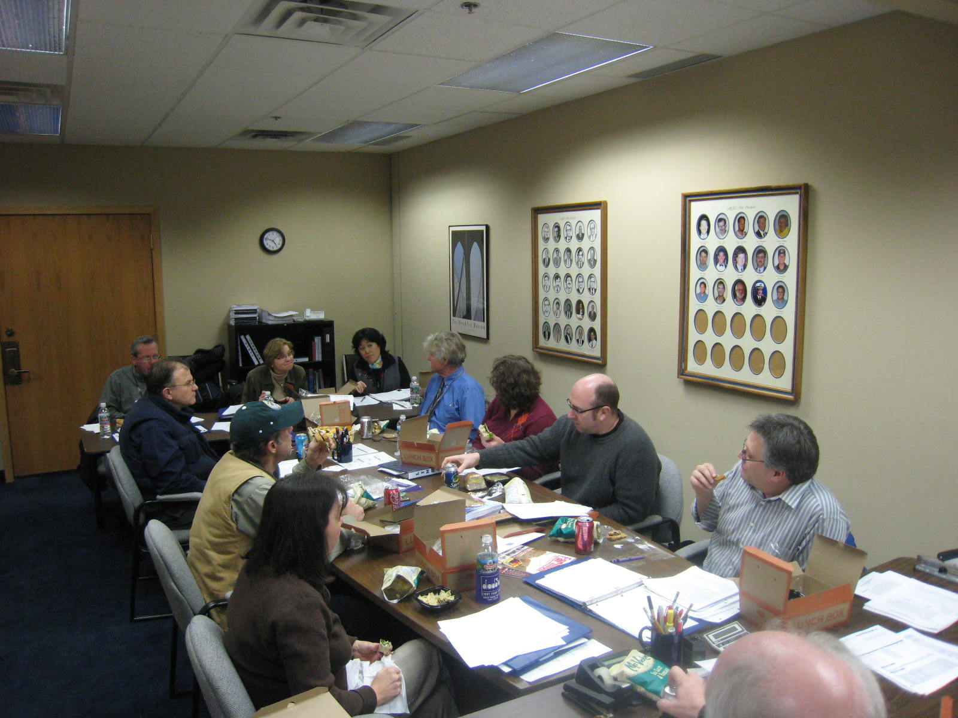
Do you remember…
Celebrating 50 years

Slide 28
2009
Celebrating 50 years
President Peter Buchen, new Board Members Rachel Guan and Linda Taylor, and the Board meet to discuss issues of the day: Legislation for a wage freeze, elimination of collective bargaining for period 7/1/09 to 6/30/11. House File 586 authored by Rep. Drazkowski with companion Senate File 372.

Slide 29
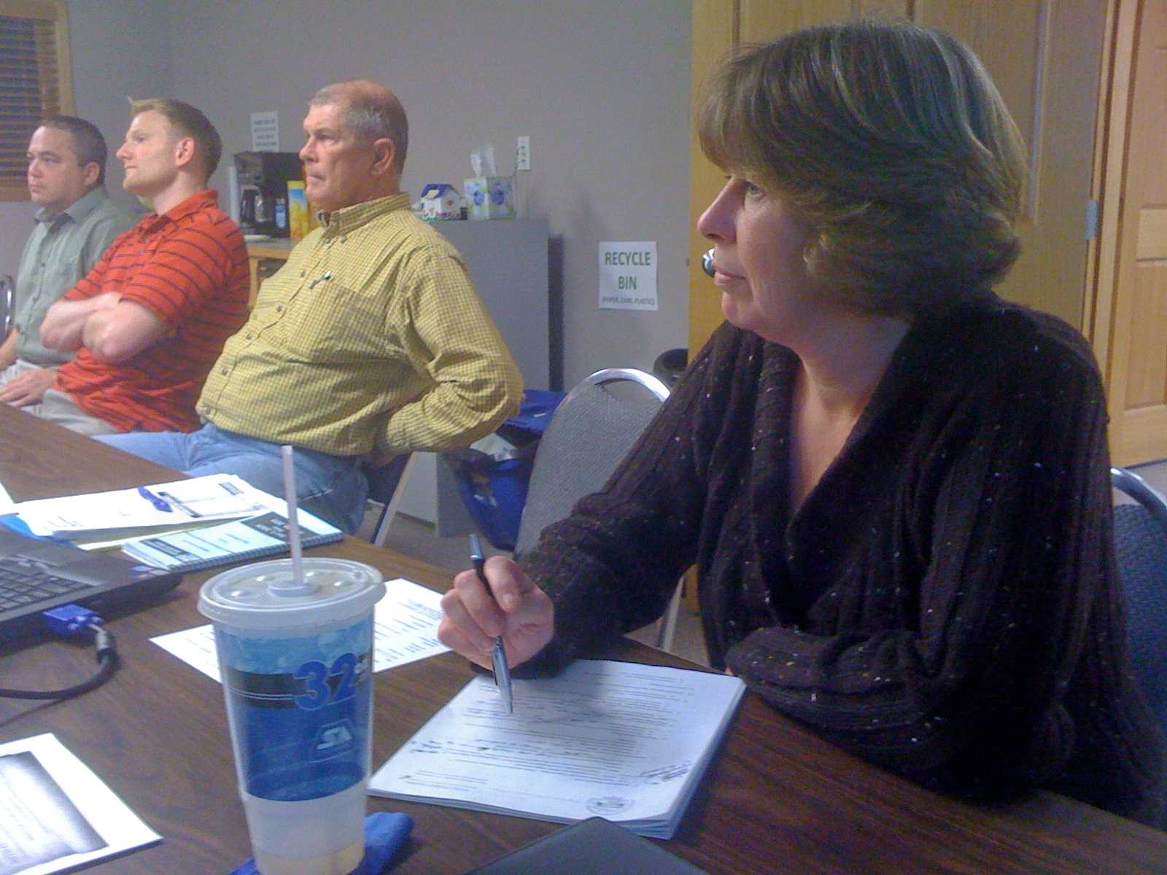
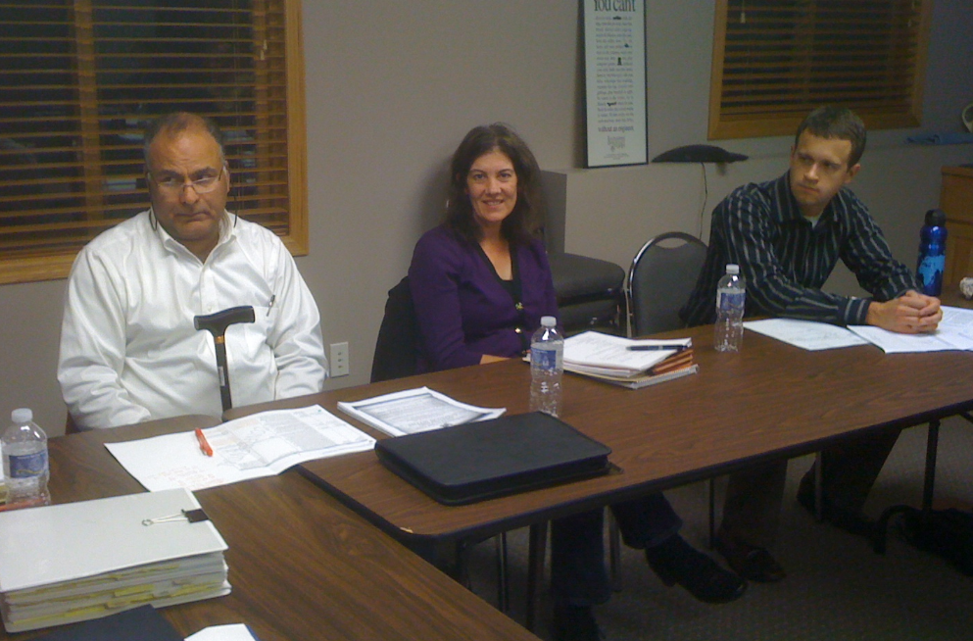
Do you remember…
Celebrating 50 years

Slide 30
Do you remember…
Celebrating 50 years
Some of your representatives in 2011 at a regular board meeting:
Jerry Kotzenmacher, Andrew Eller, Mike Lownsbury, Ann Driver (left) Mohammad Dedashti, Linda Heath, Ryan Wilson (right)

Slide 31
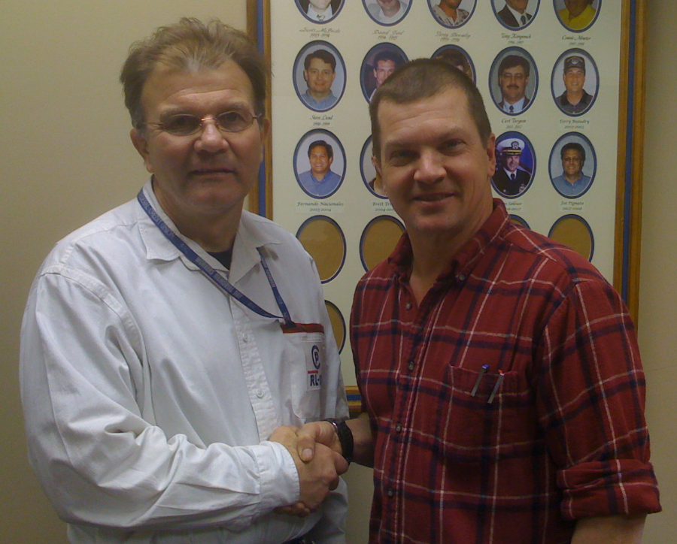
Do you remember…
Celebrating 50 years

Slide 32
Year…
Celebrating 50 years
Jim Sellner and colleague (from water resources)

Slide 33
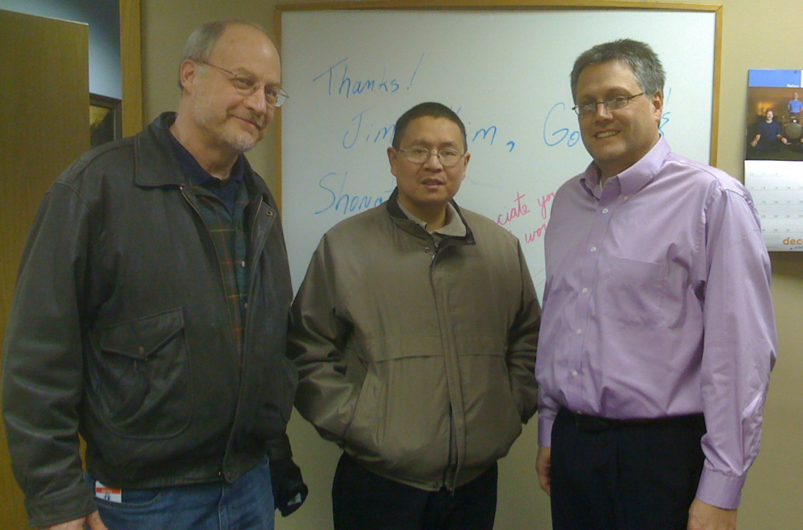
Do you remember…
Celebrating 50 years

Slide 34
Year…
Celebrating 50 years
Some of your representatives in 2011 at a regular board meeting:
Gordy Bergstrom,
Shongtao Dai,
Joe Pignato

Slide 35
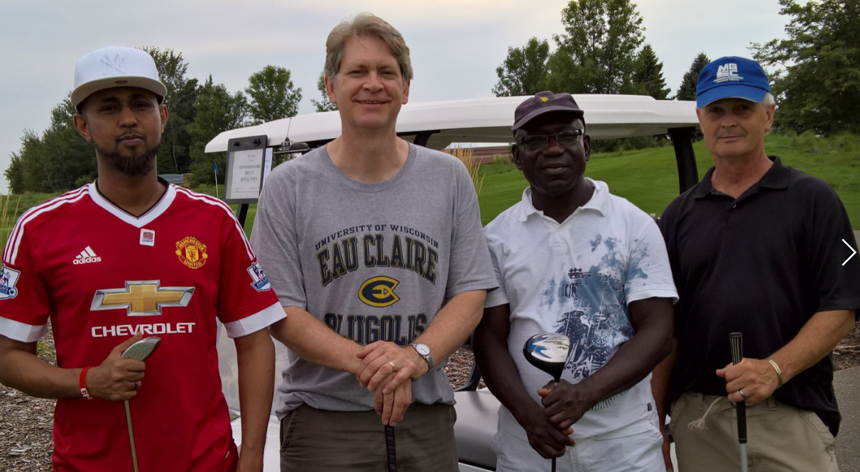
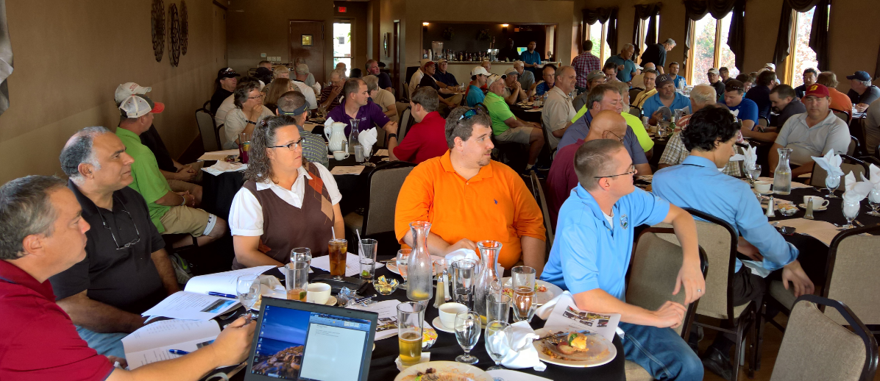
Do you remember…
Celebrating 50 years

Slide 36
2016
Celebrating 50 years
The MGEC Golf Tournament and Annual Meeting was held here at the Oak Marsh Golf Course

Slide 37
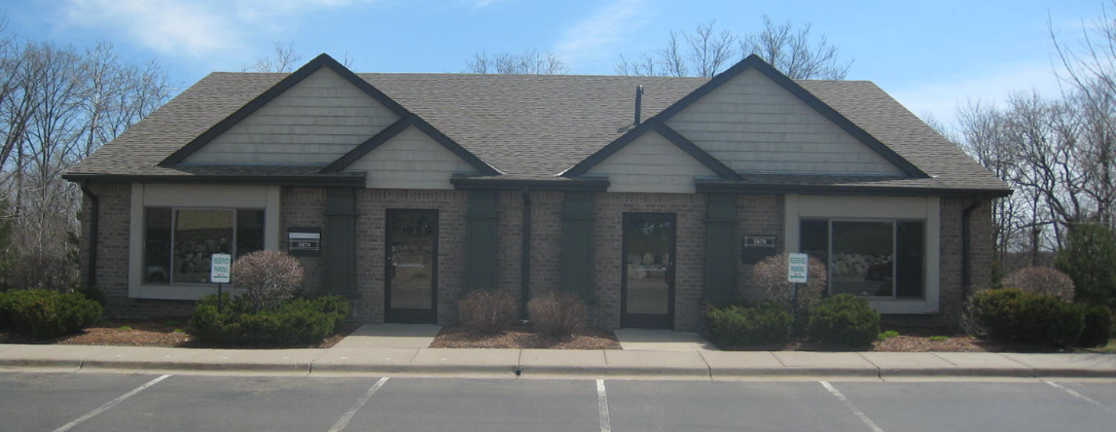
TRIVIA:
When did MGEC move into our current building in Inver Grove Heights?
Celebrating 50 years

Slide 38
ANSWER:
MGEC moved in 2011. MGEC paid cash for the building; the purchase has helped keep fees low.
Celebrating 50 years
We rented our previous office space for about $1,200/month; the investment results in a savings of about $15,000 annually.

Slide 39
TRIVIA:
When did MGEC move into our current building in Inver Grove Heights?
Celebrating 50 years

Slide 40
ANSWER:
Only FOUR members have served more than one term as president in MGEC’s 50 year history:
Terry Beaudry, Jim Sellner, Mohammed Dedashti, and Steve Kordosky
  Terry Beaudry (MnDOT): 1995-1996, 2002-2003,
  Jim Sellner (DNR) 2000-2001, 2006-2007
  Mohamed Dedashti (MnDOT): 2012, 2015
  Steve Kordosky (MnDOT): 2016, 2018
Celebrating 50 years

Slide 41
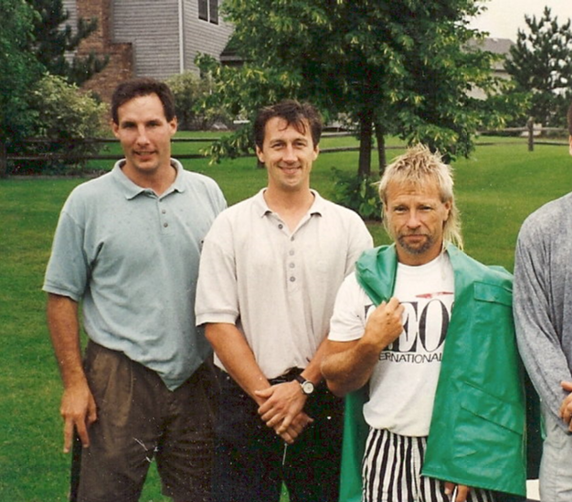
Do you remember…
Celebrating 50 years

Slide 42
We’re not sure what year this is, but…
Celebrating 50 years
We’re pretty sure this trio is :
Mike Reif,
Joe Korzelius,
Loren Greene(?),

Slide 43
TRIVIA:
In what two summers were there Minnesota state government shutdowns? How long did each one last?
Celebrating 50 years

Slide 44
ANSWER:
The first government shutdown in the history of the state was in 2005. The second was in 2011.
  The 2005 government shutdown lasted 9 days, until the legislature and governor passed a 'lights-on' temporary authorization of spending, followed by a compromise budget agreement.
  In 2011, there was another government shutdown lasting 20 days, after Governor Pawlenty's outgoing administration left a $5 billion shortfall in the budget. The shutdown started at midnight on July 1, and ended after a budget bill was passed and signed on July 20.
Celebrating 50 years

Slide 45
2008
Awards Committee Chair Len Leitner (MnDOT) (left) and President Pignato present the 2008 Golden Slide Rule Award to Dave Dahlberg (MnDOT) (center)
Celebrating 50 years
Directors Jerry Kotzenmacher, Andrew Eller, Mike Lownsbury, Ann Driver

Slide 46
2008
Awards Committee Chair Len Leitner (MnDOT) (left) and President Pignato present the 2008 Golden Slide Rule Award to Dave Dahlberg (MnDOT) (center)
Celebrating 50 years
Directors Jerry Kotzenmacher, Andrew Eller, Mike Lownsbury, Ann Driver

Slide 47
TRIVIA:
How many Directors are on the MGEC board?
Celebrating 50 years

Slide 48
ANSWER:
Joe Pignato Oct 2007- Dec 2008 when presidential terms changed
  The MGEC board has 5 offices (President, Vice President, Past President,
Celebrating 50 years

Slide 49
TRIVIA:
Who was the longest serving single-term MGEC president?
Celebrating 50 years

Slide 50
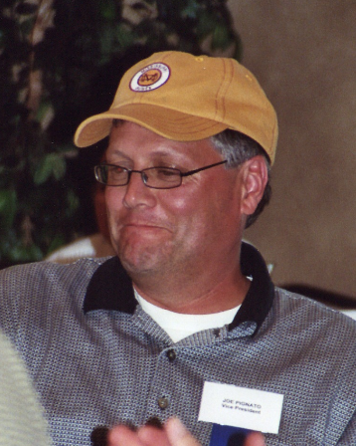
ANSWER:
Joe Pignato
  Joe Pignato served from October 2007 through December 2008 when Director, and officer terms changed. He served a single term following the second (non-consecutive) term of Jim Sellner.
Celebrating 50 years

Slide 51




